Slide 1
DMRC Stanford Hall High Performance Clinic
Consultant level Sport and Exercise Medicine (SEM) input to the management of MSK injury in high level athletes or special forces
Multi-disciplinary team includes consultant (SEM), Physio (with MSc) and ERI (with BSc)
Eligibility criteria
Currently representing their sS or UKAF in the last year / season and are identified by a Sports Control Board (SCB) representative
A service person (SP) engaged in a National Governing Body (NGB) programme; or on a Talented Athlete Scholarship Scheme (TASS); or on a professional contract
Actively serving under the Directorate of Special Forces (DSF)

Slide 2
High Performance Clinic
Referrals are to be initiated by unit medical officer or sports medical team using FMed7 send to DMRC via DMICP
Address referral to HPC, include confirmation from sport / coaching staff that they are active members of their team and recognised by SCB representative
Annex A no longer needed
Organisations external to DMS refer via letter

Slide 3
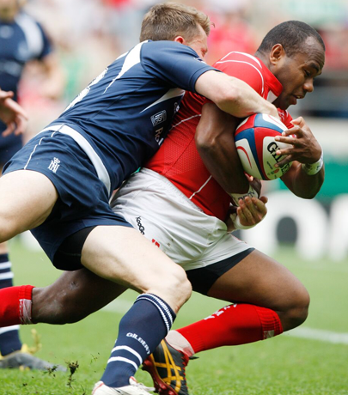
High Performance Clinic
21 days of injury or recent episode of sporting medial attention which require specialist management to return to sport or duty
Injuries not restricting sport representation - manage locally
Referrals are triaged by lower limbs team Consultants
Appt sent to referring medical centre via admin list

Slide 4
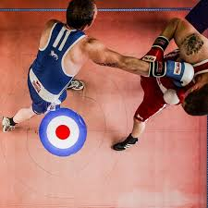
High Performance Clinic
FMed7 will follow patient assessment
Communication to external organisations via letter (copy to medical centre)
Discussions to occur between HPC and sports team if needed (with patient consent)
Visibility of previous medical intervention crucial
Recommend 6 monthly update from sports team to patients’ Defence Healthcare Record (DHR)
POC Maj Sarah Williams or LL team 95238 3007 or 3018

